Slide 1


Login
Register
Home
Repair Projects
For Business
Support
Dev Info
Get Started
Daniyal Sultan – S11215227
Navneel Prasad – S11219957
Sharvik Sharma – S11220315
Shamal Prasad- S11219545
Shreshtha Sharma – S11220274

Slide 2
Introduction
Handy Helpers is a marketplace for home repair services, connecting vendors with clients across Fiji.
Provides a comprehensive platform for various home repair services.
Enables flexible sign-up for vendors and a range of service options for clients.
Facilitates connections between local vendors and consumers.

Slide 3


Login
Register
Home
Repair Projects
For Business
Support
Dev Info
Login Redirection
Login as a Customer
Login as a Business
Telephone:
Terms & Conditions
Dev Info
Repair Projects
Our Partners
Feedback
© HandyHelpers.com 2024
+679-8569258
Mail:
handyhelpers@gmail.com

Slide 4
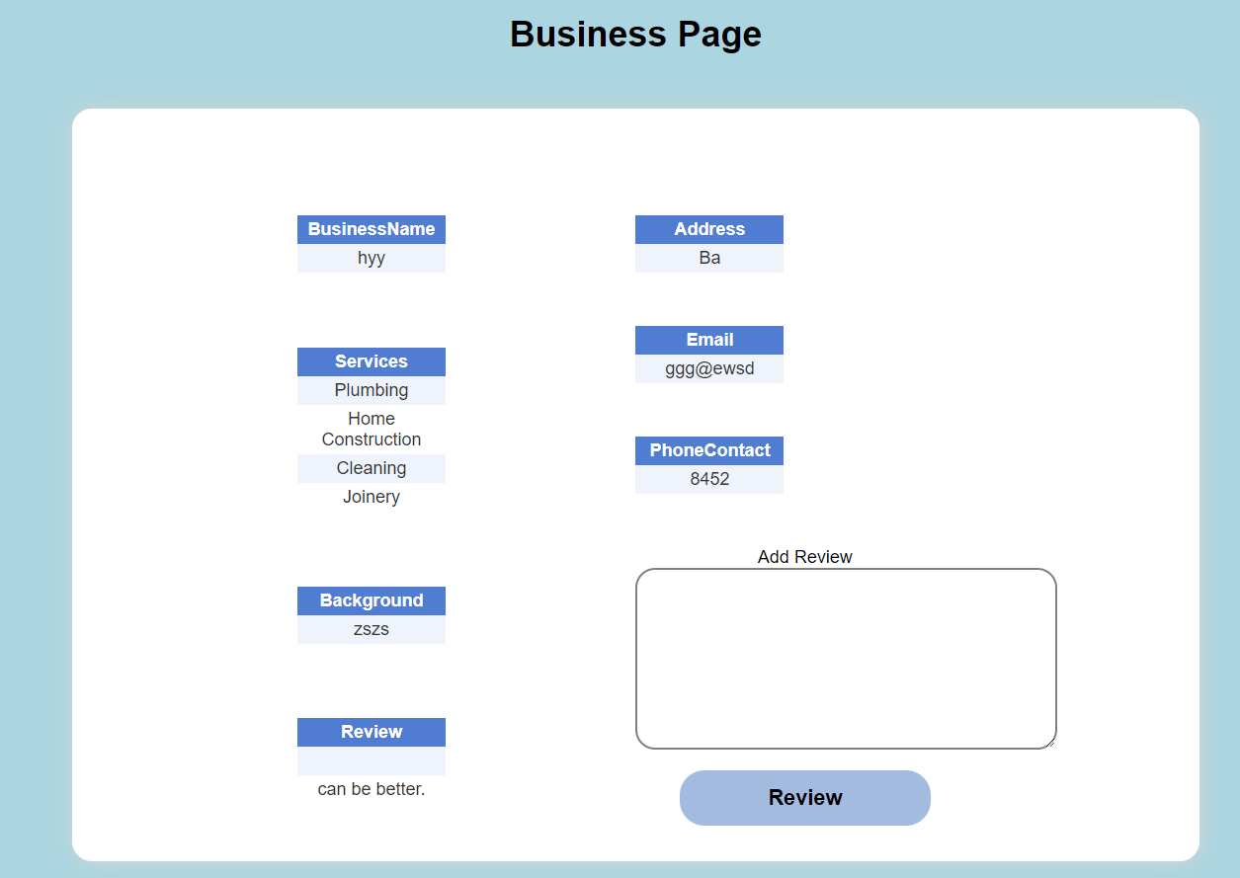
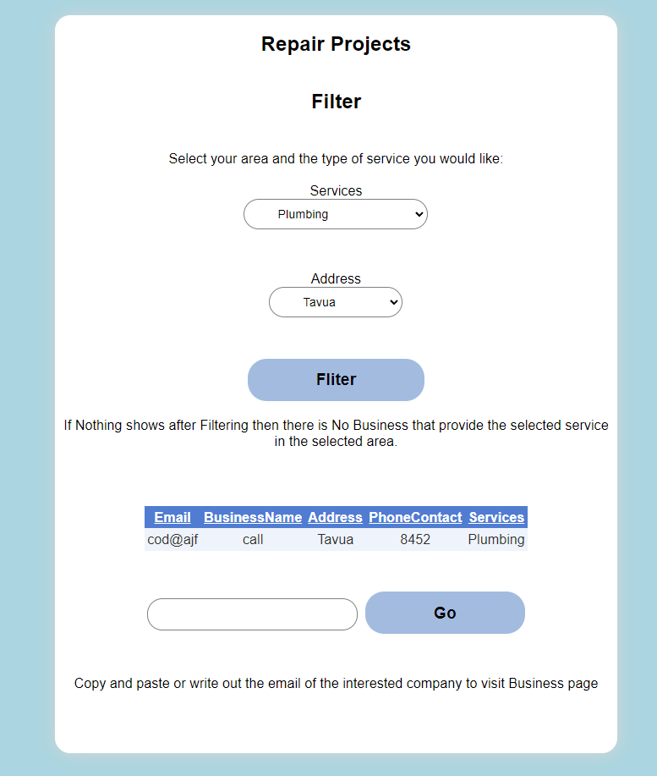
Content Goals
Billboard: Establishes business presence.
Special Interest: Targets homeowners and property owners.

Slide 5
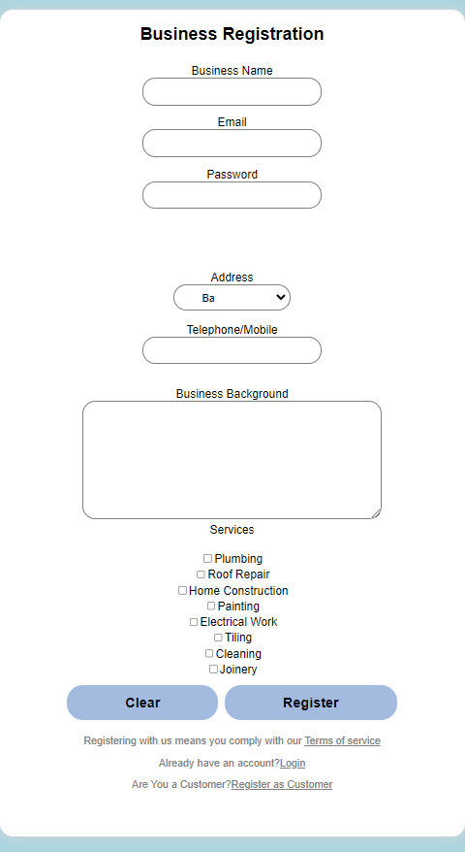

Extranet: Restricted access for registered vendors and businesses.
Geographic Expansion: Reaches a wide network across Fiji.

Slide 6

Audience
Primary Audience: Homeowners, Commercial Property Owners, Business Owners
Secondary Audience: Acquaintances, Curious Individuals
Demographic Audience:
Gender: Predominantly male, but inclusive of females in related fields.
Age Group: Late twenties and older.
Nationality: Primarily Fijian, with potential international interest.

Slide 7

Site Content
Content Offered
Home Page: Introduction and services overview. (Welcome and inform users)
Home Repair Projects Page: List and filter home repair services. (Easy service search)
For Business Page: Vendor signup and service promotion info. (Attract vendors)
Business Page: Vendor service summary, location, ratings. (Evaluate and contact vendors)
Business Profile Page: Vendor service management. (Update service offerings)
User Profile Page: Account management and booking history. (Personalized user experience)
Support Page: User and vendor support contacts. (Dedicated help)

Slide 8
Functional Requirements
User Sign-in/Signup:
Account creation and login for access to profile and features.
Register via webform; info stored in customer database.
Business Sign-in/Signup:
Vendor account creation and profile setup.
Register via webform; info stored in business database.
Filter and Search:
Filter services by type and location.
Select criteria to filter results.
Review System:
Customers leave service reviews.
Business adds client email; clients review services.
Contract Record:
Record client emails to allow reviews.
Businesses input client emails; clients can review.

Slide 9
Security Measures
User Authentication: Only registered users can access certain features. (Maintain integrity)
Data Protection: Encrypt and securely store user/business info. (Ensure confidentiality)
Secure Connections: Use SSL/TLS for secure data exchange. (Prevent breaches)
Regular Backups: Automated data backups. (Data recovery)
Password validation: it has a minimum length of 8 (alphanumeric)

Slide 10
Login
Register
Home
Repair Projects
For Business
Support
Dev Info
Business Page
Business Name
Address
Email
Services
Phone Contact
Background
Add Review
Review
Review
Telephone:
Terms & Conditions
Dev Info
Repair Projects
Our Partners
Feedback
© HandyHelpers.com 2024
+679-8569258
Mail:
handyhelpers@gmail.com

Slide 11


Login
Register
Home
Repair Projects
For Business
Support
Dev Info
Repair Projects
Filter
Select your area and type of service you would like:
Services
Address
Filter
If nothing shows after filtering, then there is no business that provide the selected service in the selected area.
Email Business Name Address Phone Contact Services
Go
Copy and paste or write out the email of the interested company to visit Business Page.
Telephone:
Terms & Conditions
Dev Info
Repair Projects
Our Partners
Feedback
© HandyHelpers.com 2024
+679-8569258
Mail:
handyhelpers@gmail.com

Slide 12

Site Structure
Handy Helpers uses a web structure format.
Users can navigate freely with low chances of getting lost.
Home Repair Projects page can be accessed directly from the home page.

Slide 13
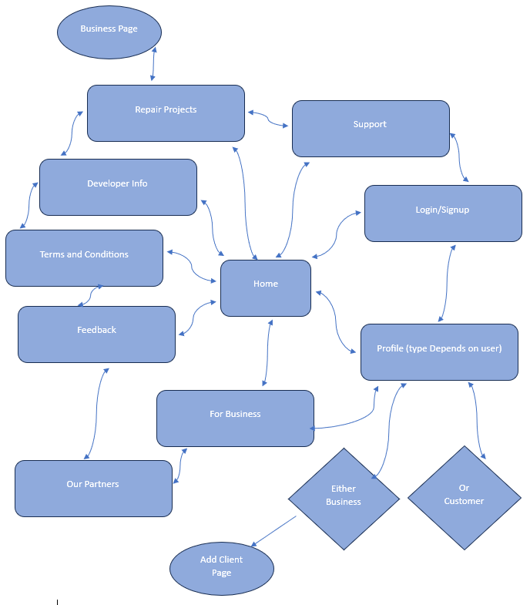
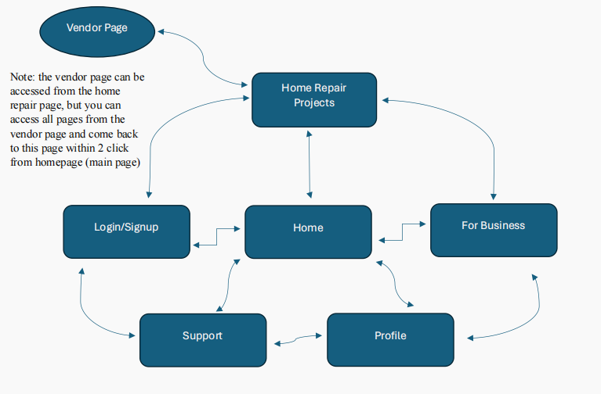
Sitemap

Slide 14
Sitemap
ORIGINAL SITE STRUCTURE
ADJUSTED SITE STRUCTURE

Slide 15


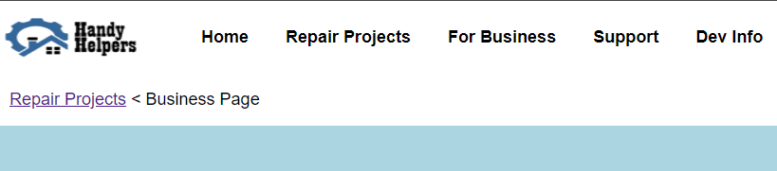
Each page has a consistent header and footer
Breadcrumbs are available on certain pages for ease of access and navigation

Slide 16
Site Navigation
Where am I?: Breadcrumbs and highlighted navigation bar.
Where can I go?: Use the navigation bar to access different pages.
How can I get there?: Navigation bar for locating services or information.
How do I get back to where I started?: Use navigation bar or breadcrumbs.

Slide 17
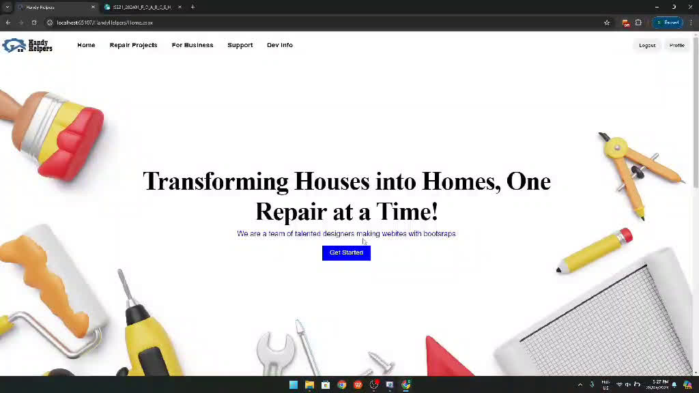

Slide 18
Website Layout
Active/passive white space:
Content centered in active white space.
Passive space on sides for order. Add the webforms and blah blah shit
Unified design:
Consistent theme with complementing colors and fonts.
Content in tightly packed rectangular design.
Smooth transition:
Consistent rectangular design across pages.
Uniform theme for seamless transition.

Slide 19
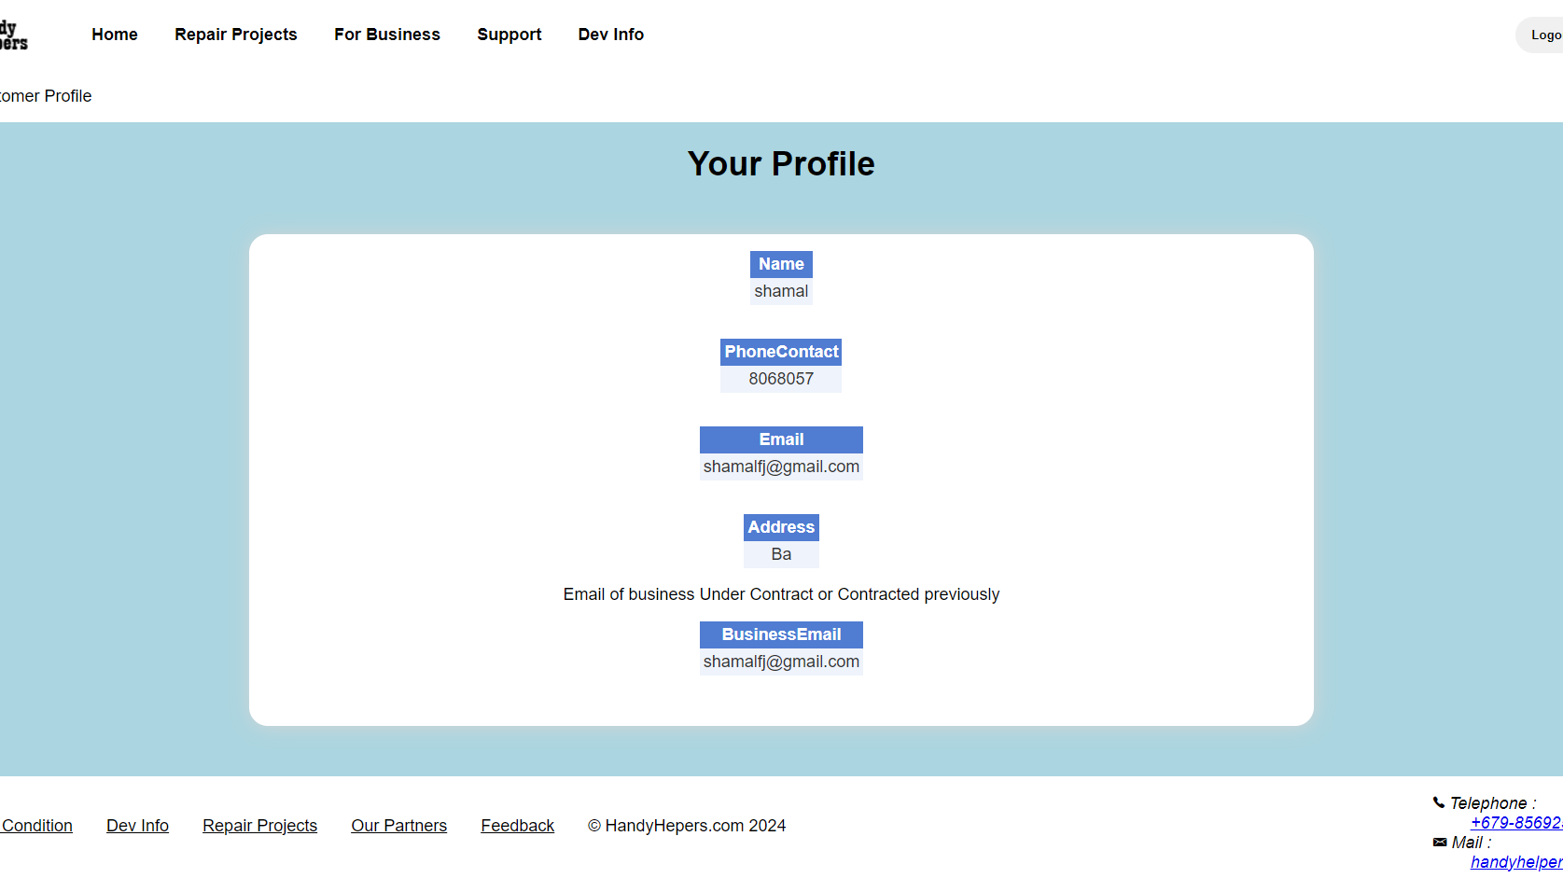
Login
Register
Home
Repair Projects
For Business
Support
Dev Info
Passive Space
Passive Space
Active Space
Telephone:
Terms & Conditions
Dev Info
Repair Projects
Our Partners
Feedback
© HandyHelpers.com 2024
+679-8569258
Mail:
handyhelpers@gmail.com

Slide 20
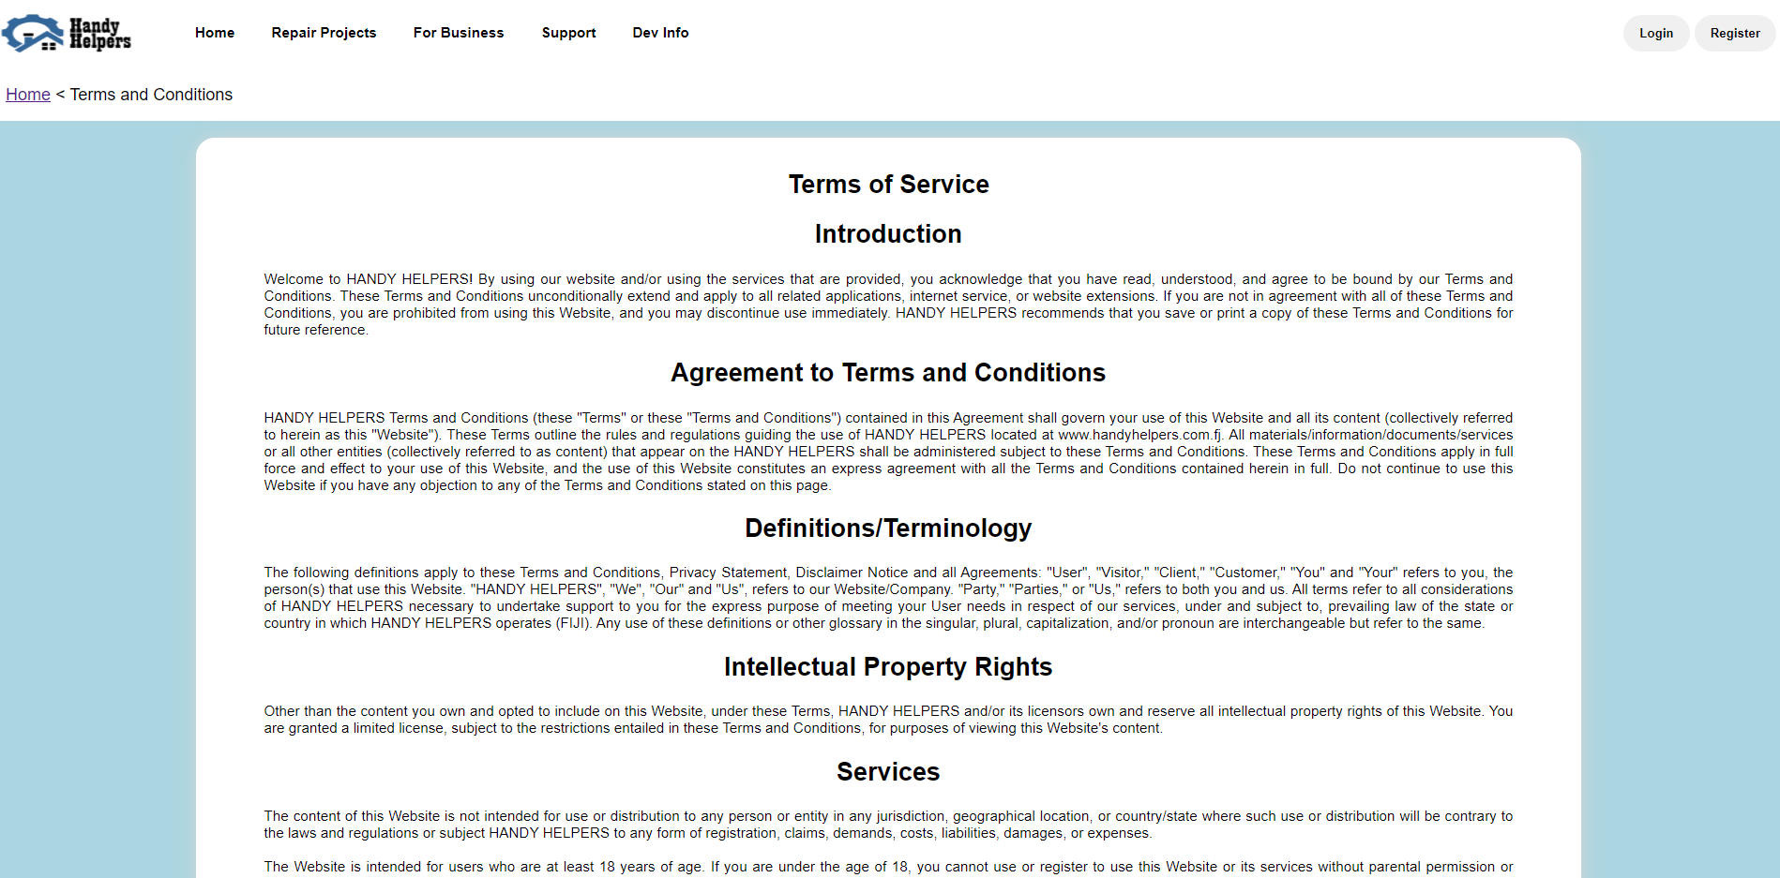
Active Space
Passive Space
Passive Space

Slide 21





Testing
Browsers Tested:
Almost all browsers displayed content in the same manner and processed backend scripting language similarly.
Specific notes on browsers like Microsoft Edge and Opera having default sidebars.
Google Chrome was the most consistent and widely used.

Slide 22

Conclusion
Handy Helpers provides a comprehensive platform connecting vendors and clients for home repair services in Fiji, meeting the needs of homeowners, property owners, and businesses. Our website is designed with user-friendly navigation, essential functionalities, and robust accessibility features, ensuring a seamless experience for all users. We have thoroughly tested the site for optimal performance and security.
Thank you for your attention.
Questions

Slide 23
REFERENCES AND YOUTUBE LINK
https://www.youtube.com/watch?v=pXc1BBVfm2Q – link to YouTube video
Dayal Steel PTE LTD. (n.d.). Facebook. Retrieved May 29, 2024, from
https://scontent.fcbr1-1.fna.fbcdn.net/v/t39.30808-6/435127467_1235675474089494_7442063150076688370_n.jpg?_nc_cat=100&ccb=1-7&_nc_sid=5f2048&_nc_ohc=-adl-eyYdCAQ7kNvgEaPGj4&_nc_ht=scontent.fcbr1-1.fna&oh=00_AYBMc_LNNZ-nR0oMeRMsq3E-h6TURhS35DJvESzpkHp2Nw&oe
R. C. ManuBhai & Co. PTE LTD. (n.d.). Facebook. Retrieved May 29, 2024, from https://scontent.fcbr1-1.fna.fbcdn.net/v/t39.30808-6/327343563_493164019437165_3915999828498058511_n.jpg?_nc_cat=100&ccb=1-7&_nc_sid=5f2048&_nc_ohc=ed0TQrZEJrwQ7kNvgGTwIZE&_nc_ht=scontent.fcbr1-1.fna&oh=00_AYDFwXlNhniKxx5VMtANn1sjPg4nmIgufSyKf2SpuS579g&oe=
Vinod Patel. (n.d.). LinkedIn. Retrieved May 29, 2024, from https://www.google.com/url?sa=i&url=https%3A%2F%2Fwww.linkedin.com%2Fcompany%2Fvinodpatelgroup&psig=AOvVaw35lUjHkjKTIoha4TZSczaB&ust=1716901827597000&source=images&cd=vfe&opi=89978449&ved=0CBAQjRxqFwoTCLCf3Zz0rYYDFQAAAAAdAAAAABAE
6 images used from Pinterest - Pinterest. (n.d.). Pinterest. Retrieved May 29, 2024, from https://www.pinterest.com/

